Slide 1
Music Sentiment Analyzer
Yonathan Cahyadi (n10149953)
Yanmei(Kiki) Zeng (n10307389)

Slide 2
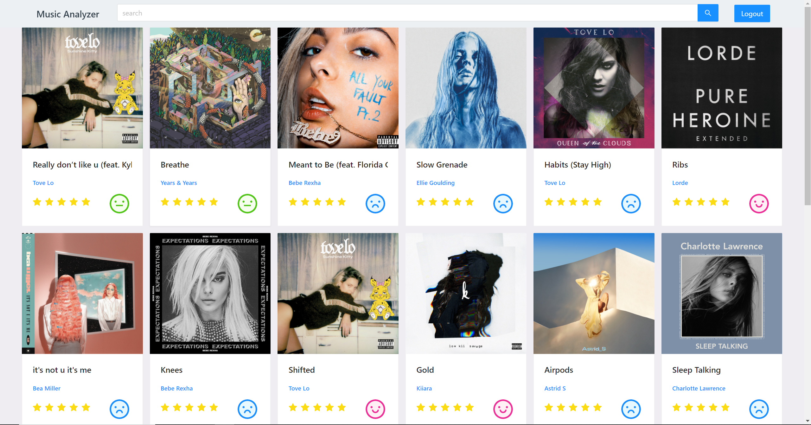
The App
Allowing User to search for music
Allowing User to see the lyric of the music
Analyzing the sentiment of the music based on the lyric

Slide 3
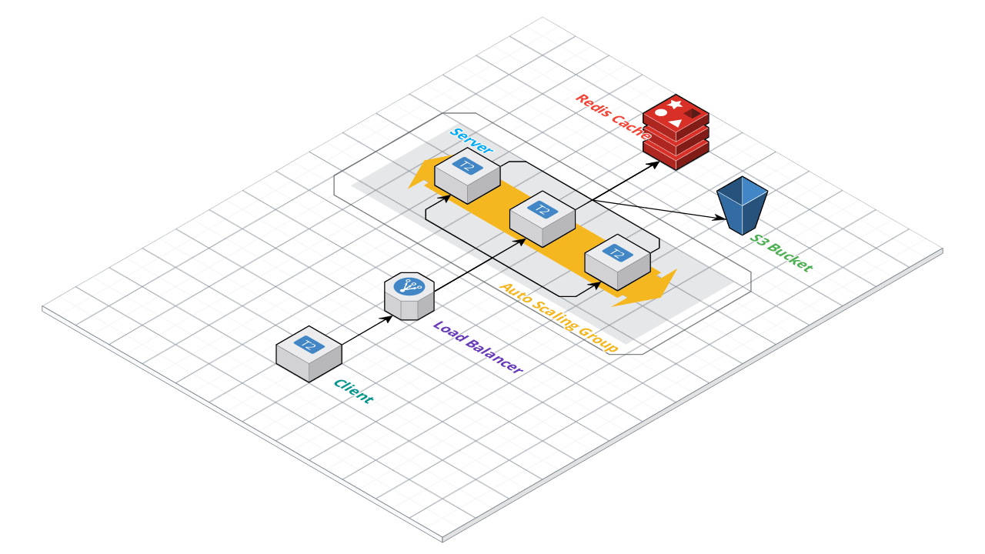
The Architecture

Slide 4
Scaling

